Slide 1
The Change in the world of work and the implications for the future career opportunities and job search strategies
Institution Affiliation
Students’ Name
Date of Presentation

Slide 2
Introduction
The workplace is changing fast, and not just because of automation and the introduction of new technologies.
Some 20 years or so before, no one would dream of wearing a pair of jeans to work, but now, that is almost the norm.
You probably grew up hearing tales of the stringent nature of the world of work, and as you enter or grow in your career, most of the traditional rules no longer apply.
New technologies have changed how people work and collaborate on duties, and this has had an impact on the lives of individuals, and more is yet to come.

Slide 3
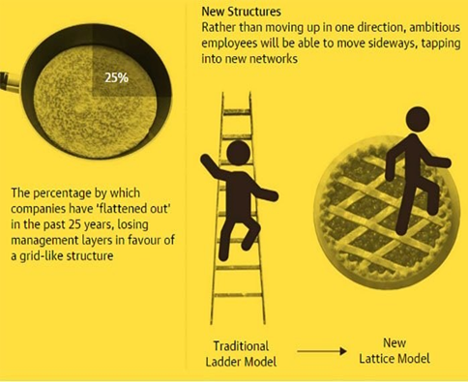
The change in the workplace structure
This is brought by the collapse of the corporate ladder.
Loyal workers scrambled towards the higher ranks of management to get promotions at a time.
Currently, most of the companies have flattened out by about 25% over the past years, losing several layers of management in favor of a more grid-like structure that causes employees to move along horizontal, vertical and diagonal ways.
Notes:
One of the critical workplace changes in the 21st century has been the collapse of the corporate ladder. Loyal workers scrambled towards the higher ranks of management to get promotions at a time. This new diversity, combined with technological advances, has fed demand for a more collaborative and flexible working environment (The Guardian 2020). Currently, most of the companies have flattened out by about 25% over the past years, losing several layers of management in favor of a more grid-like structure that causes employees to move along horizontal, vertical and diagonal ways. For the future strategies to job opportunities, I would suggest for the lattice model. It provides more opportunities and possibilities that are successful. With the lattice model, one can do different roles and build new experiences, new skills, and adapt to the new system of work.

Slide 4
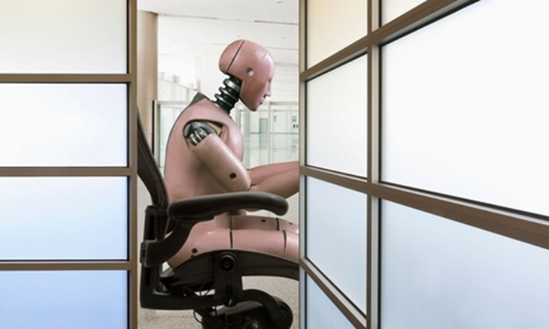
The development of artificial intelligence
Artificial intelligence is associated with the use of robotic machines to replace human labor.
Even though they can help to increase the production capacity and convenience, they are also destructive as they render entire professions and causing joblessness to many people.
They can be used to do most of the work including manual work, where most of the factories use robots as well as white collar jobs.
Notes:
The emergency of robots machines is increasing, and the future predictions show that they can cost millions of jobs as a result of human replacement. Even though they can help to increase the production capacity and convenience, they are also destructive as they render entire professions and causing joblessness to many people. The most affected part is the area of manual work, where most of the factories use robots (Meyer, 2012). These robots can overwork, and they do a variety of work, including packaging, loading, and offloading. In short, work that requires coordination between hand and eyes can be done by the low-cost, efficient mechanical devices. These do not only sound in manual labor but also white-collar jobs are at high risk as sophisticated software that can handle different types of social work are developed. The strategy that can be used to counter-attack this automation is by encouraging more people to venture into jobs and concentrate on more creative and thoughtful activities to increase their job opportunities.

Slide 5

Rise of the Gig Economy or Freelancing
There has been a proliferation of online platforms that match employers with freelancers who invite them to bid for each task.
They have created a market that is evolving so quickly that it’s hard to pin down exactly how many people are using these sites across the world.
They are also associated with some benefits for companies that use these sites like getting instant access to a pool of cheap, willing talent, without having to go through lengthy recruitment processes.
Notes:
For the past five years, there has been a proliferation of online platforms that match employers with freelancers who invite them to bid for each task. They have created a market that is evolving so quickly that it’s hard to pin down exactly how many people are using these sites across the world. But the management consultants McKinsey estimate that by 2025 some 540 million workers will have used one of these platforms to find work. According to Maclean & Wilson, (2009), they are also associated with some benefits for companies that use these sites like getting instant access to a pool of cheap, willing talent, without having to go through lengthy recruitment processes. Therefore, people with the right skills can start their small consulting gigs or take up such gigs along their full-time jobs.

Slide 6
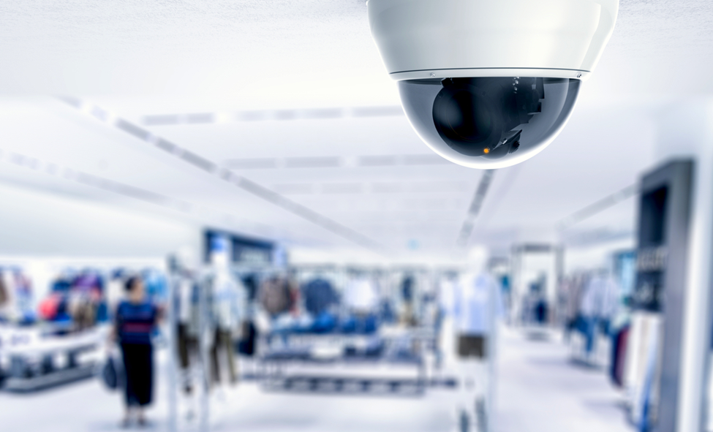
Workplace monitoring
Employees use trackers that show the exact location where their employees are working from.
CCTV cameras are installed at varies places of work that provide images and videos of the activities that go through at a specific workplace at a particular time.
Notes:
Most of the employers in the current world are finding it easier to monitor their workers at a distance, especially with the improvement in the level of technology (Quinlan, 2012). They use trackers that can show the exact location where their employees are working from. CCTV cameras are installed at varies places of work that provide images and videos of the activities that go through at a specific workplace at a particular time. These have reduced the manual movement by supervisors from place to place to monitor their employees. Many employees object to being observed. Even if the stated goal is to improve their health, the awareness of scrutiny, and the pressure to meet targets at all times can cause anxiety, offsetting any increases in wellbeing.

Slide 7
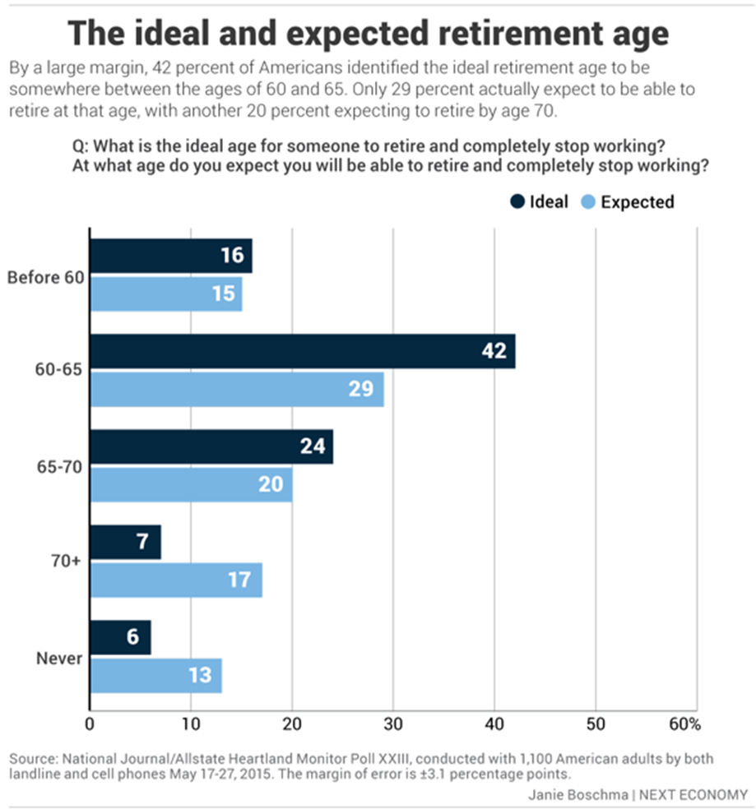
Increase in the age of retirement
The life expectancy of people is anticipated to increase across the world in the coming years.
Therefore people will work for more years.
The predicted trend speculates that the world is approaching the end of retirement and enters a period where older workers will stop working gradually rather than abruptly when they reach retirement age.
Notes:
According to the world health organization, the life expectancy of people is anticipated to increase across the world in the coming years. Therefore people will work for more years. The predicted trend speculates that the world is approaching the end of retirement and enters a period where older workers will stop working gradually rather than abruptly when they reach retirement age. Currently, the retirement age stands at 65 for men and 62 for women in the United States, but it is likely to rise to 70 as predicted by 20% for both in the future. Maclean & Wilson (2009) also suggested that people should venture into side hustles as a safety net to supplement their incomes. The changing world of work is inculcating a sense of survival on modern-day employees, and the side hustle is now a legitimate activity.

Slide 8
Conclusion
As per the above discussions, the working system and environment undergoing dramatic changes before our eyes.
While geographical and industry-specific particularities might exist, the macro shift in today’s open talent economy is global and applies to almost every industry sector.
Therefore, it calls for employers and employees to come to terms with a new environment in which flexibility and adaptability have priority over job security and long-term employment that is well structured and standardized opportunities.

Slide 9
References
Maclean, R., and Wilson, D. eds., 2009. International handbook of education for the changing world of work: Bridging academic and vocational learning (Vol. 1). Springer Science & Business Media.
Meyer, J.P., 2012. Commitment in a changing world of work. In Commitment in organizations (pp. 60-91). Routledge.
Quinlan, M., 2012. The ‘pre-invention of precarious employment: the changing world of work in context. The Economic and Labour Relations Review, 23(4), pp.3-24.
The Guardian (2020). Five ways work will change in the future. Retrieved from: https://www.theguardian.com/society/2015/nov/29/five-ways-work-will-change-future-of-workplace-ai-cloud-retirement-remote

